Slide 1
Object detection
Ángel Fernández Temiño

Slide 2
Index
Overview
YoloV3 Model
Mask-RCNN
Comparison of results
Conclusions

Slide 3

Overview
Study of object detection algorithm
Based on the methods of recognition, localization and classification of objects.
YOLO (You Only Look Once)
MASK-RCNN
Conjunto de datos de COCO

Slide 4
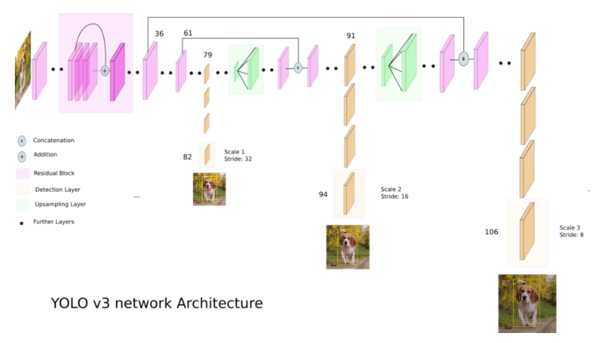
YOLO V3 MODEL
It uses a variant of Darknet.
53 new layers are stacked for detection.
Fully convolutive architecture .

Slide 5
YOLO V3 MODEL
To highlight the detection at three different scales.
1x1 detection on feature maps of 3 different sizes and in 3 different locations

Slide 6
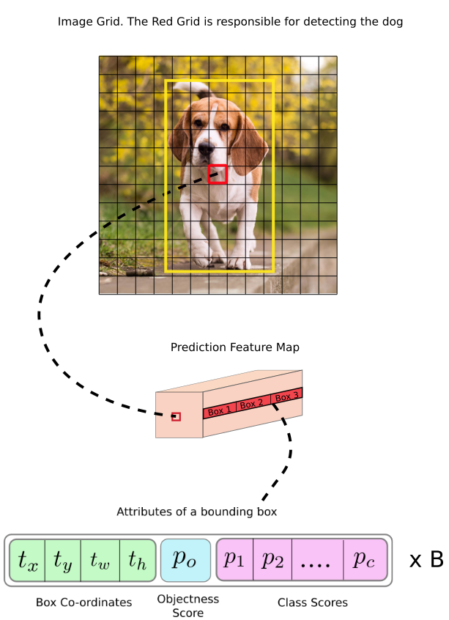
YOLO V3 MODEL
The form of the detection kernel is 1 x 1 x (B x (5 + C) ) being:
B = number of bounding boxes that a cell in the feature map can predict.
C = number of classes.
Example:
Input image is 416 x 416, with the first scale being 32. The dimensions of the feature map will be 13 x 13..

Slide 7
YOLO V3 MODEL - Installation Guide
GIT
git clone https://github.com/heartkilla/yolo-v3.git
pip install -r requirements.txt
wget -P weights https://pjreddie.com/media/files/yolov3.weights
python load_weights.py

Slide 8
YOLO V3 MODEL - Usage
GIT
python detect.py <images/video> <iou threshold> <confidence threshold> <filenames>
python detect.py images 0.5 0.5 data/images/dog.jpg data/images/office.jpg

Slide 9
YOLO V3 MODEL - Installation / Usage
Jupyter Notebook
https://colab.research.google.com/drive/10Eeffk77AH563aiKdcj7QOymab1H0GDC

Slide 10
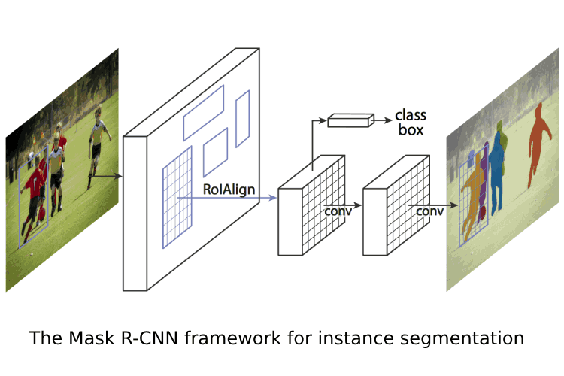
Mask-RCNN
First deep learning network to solve the instance segmentation problem.
Provide the bounding box and class for each object.
Returns the binary mask.

Slide 11
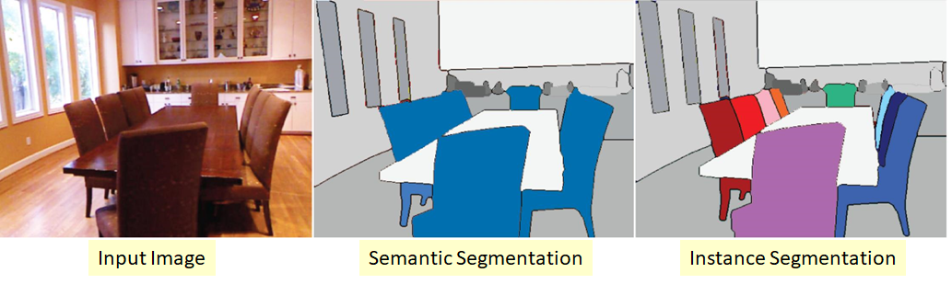
Mask-RCNN
Image segmentation is the process of dividing a digital image into multiple segments..
It is a segmentation at pixel level.

Slide 12
Mask-RCNN - Installation / Usage
Jupyter Notebook
https://colab.research.google.com/drive/1ijPgDh5Zn0vDZt1NLnn-a-5yoFx3HrD0?usp=sharing

Slide 13
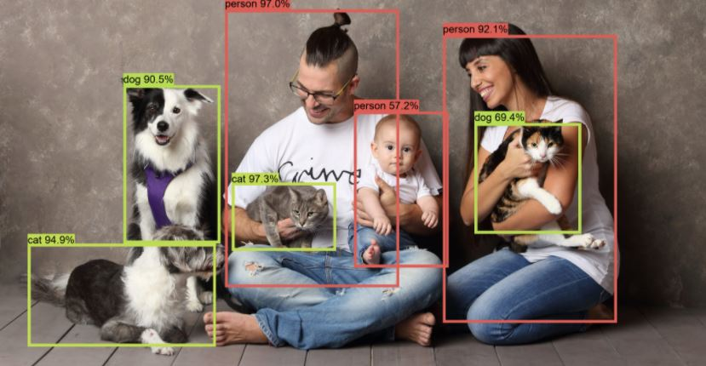
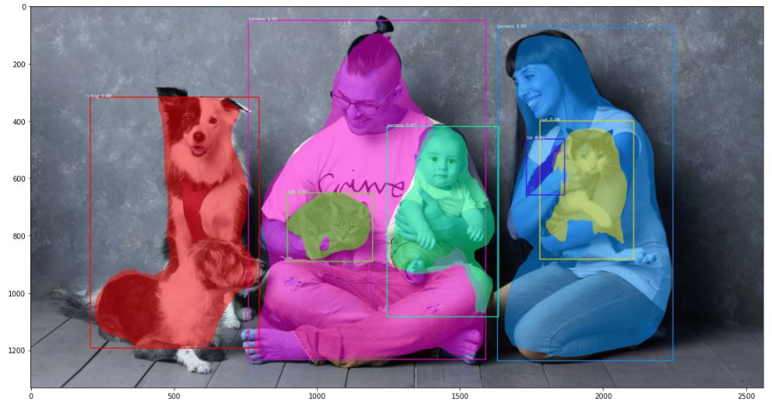
Results
Yolo V3
Mask - RCNN

Slide 14
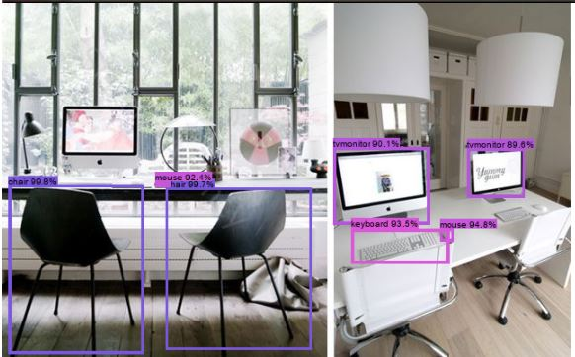
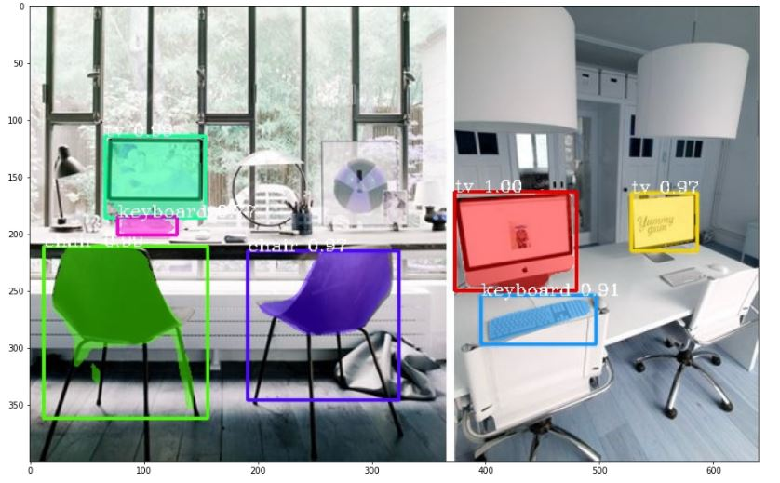
Results
Yolo V3
Mask - RCNN

Slide 15
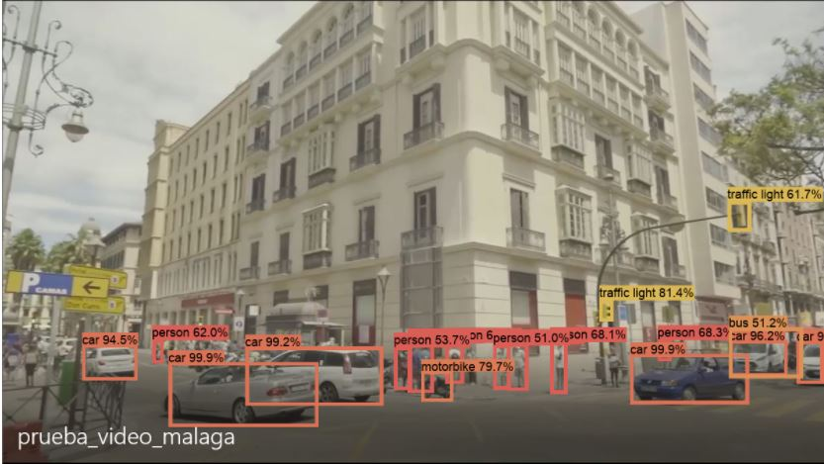
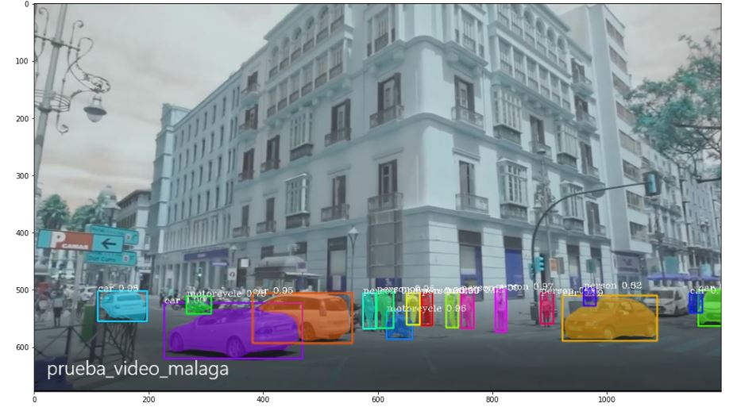
Results
Yolo V3
Mask - RCNN

Slide 16
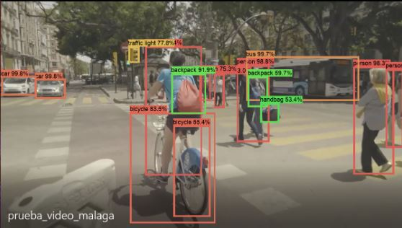
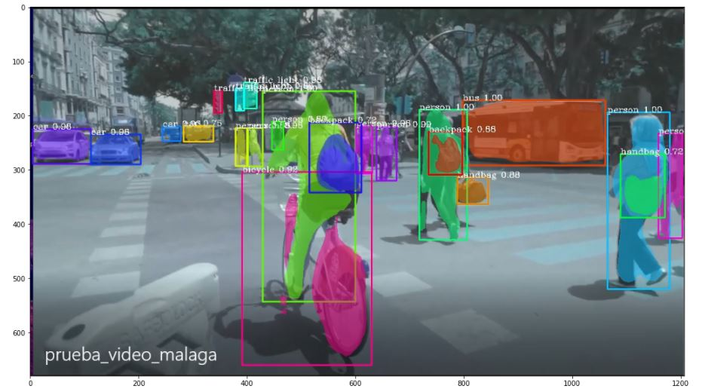
Results
Yolo V3
Mask - RCNN

Slide 17
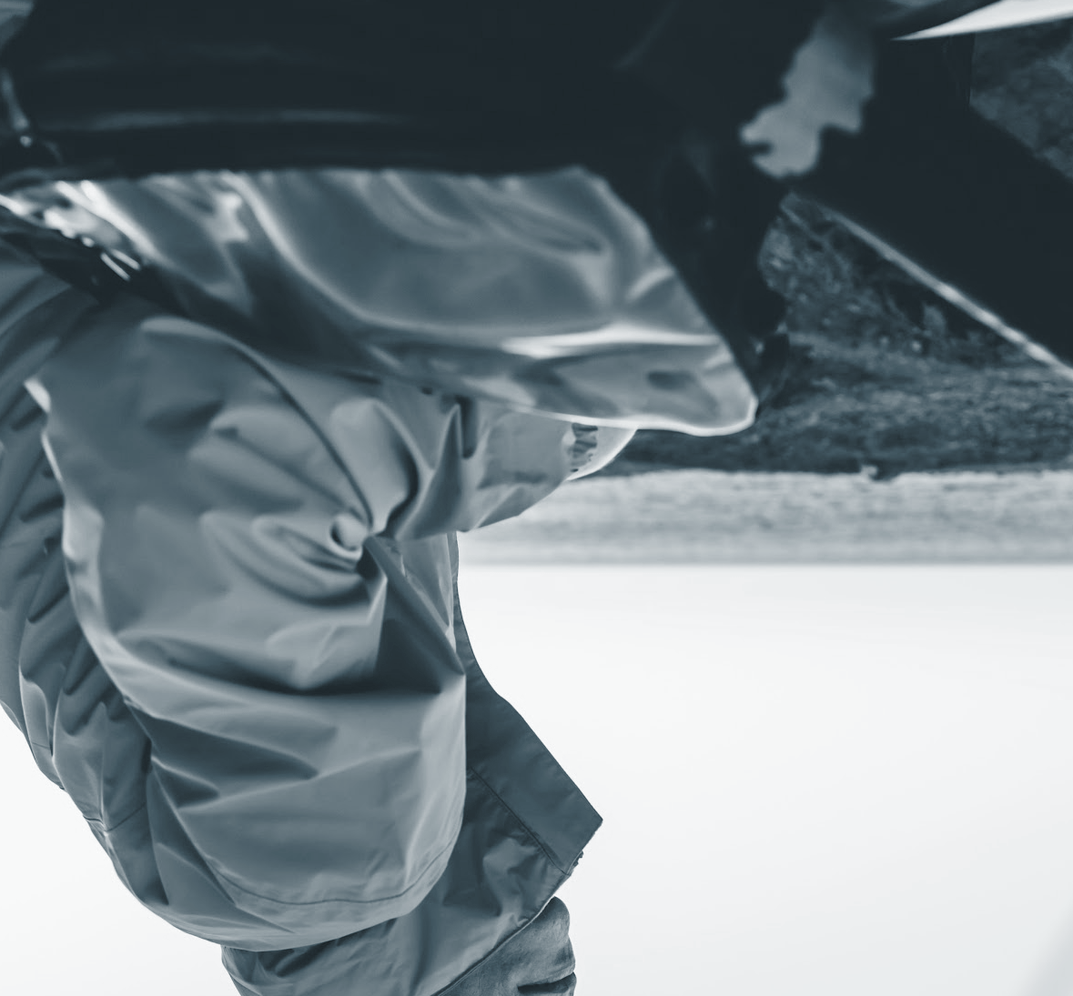
Conclusions
Mask-RCNN performs slightly better object detection compared to Yolo-V3, behaving slightly better with less frequent items.
Generally speaking, both behave quite well, something to note when the object is not so clear, Yolo-V3 shows all predictions.
Finally, we compared the execution times and found out which Yolo-V3 gives us a faster result.

Slide 18


